Slide 1



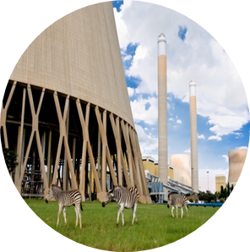

Name: Ntuthuko France
Surname: Sibiya
Mentor:
Division: Sustainability
Technician in Training
Qualification: National Diploma
Studied: Tshwane University of Technology

Slide 2
Table of Content
  Eskom life Saving Rules
  Courses
  Version Control System
  Git and GitHub
  Applications for Git and GitHub
  Advantages for Git and GitHub
  Conclusion
10 January 2017

Slide 3
Eskom Life Saving Rules
Eskom Life Saving Rules
Have a Permit to Work
Always Buckle up
Hook Up at Height
Open ,Isolate,Earth,Test ,Bond and insulate Before Touch
Be Sobber

Slide 4
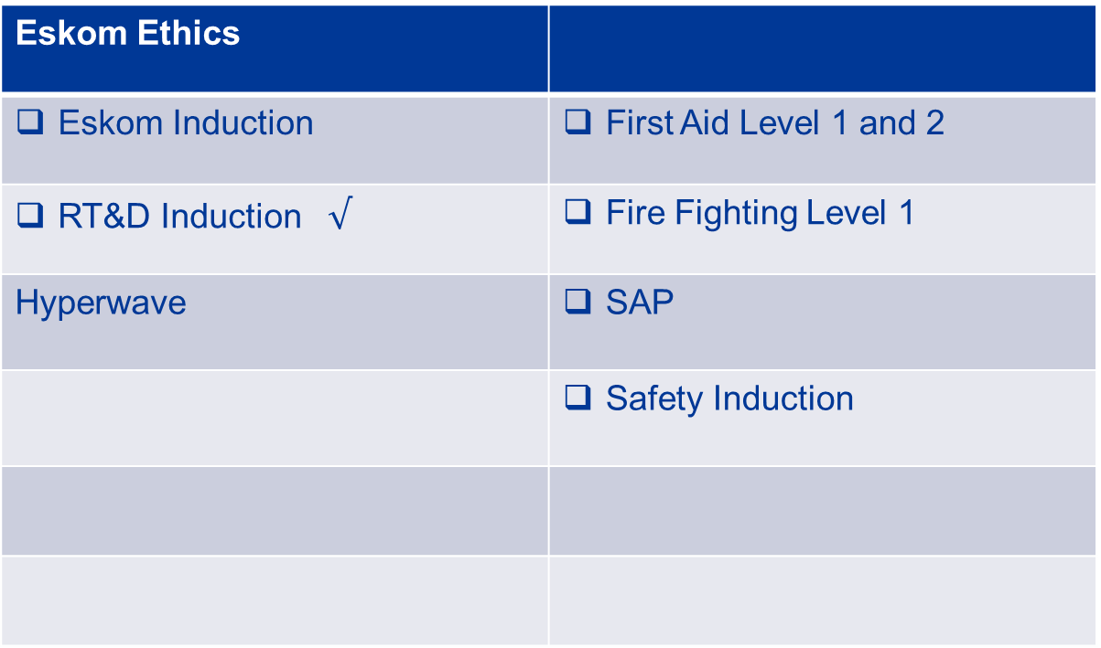
Courses
10 January 2017

Slide 5
Version Control System

Slide 8
Circuit Breaker

Slide 9
Heading

Slide 10
Heading
Add
Add
Add
Add
Add
Add
Add
Add
Add
Add
Add
Add
Add
Add
Add

Slide 11
Heading
Add
Add
Add
Add
Add

Slide 12
Heading
Add
Add
Add
Add
Add
Add
Add
Add

Slide 13
Heading
Add
Add
Add
Add

Slide 14

Thank you
Please note: this slide may also be used as a chapter divider slide.
To duplicate this slide, you need to first select this slide, go to the “Insert” drop down menu and select “Duplicate slide”. The duplicated slide can then be dragged to the appropriate position within your presentation.

